Slide 1
ATHLETE SAFETY UPDATE
SAM BAUER
ATHLETE SAFETY AND MEMBERSHIPS COORDINATOR

Slide 2
U.S. CENTER FOR SAFESPORT
USA Archery is committed to our ongoing collaboration with the U.S. Center for SafeSport to foster a culture of safety by raising awareness, centralizing best practices, and providing education and training to promote respect and prevent abuse in sport.

Slide 3
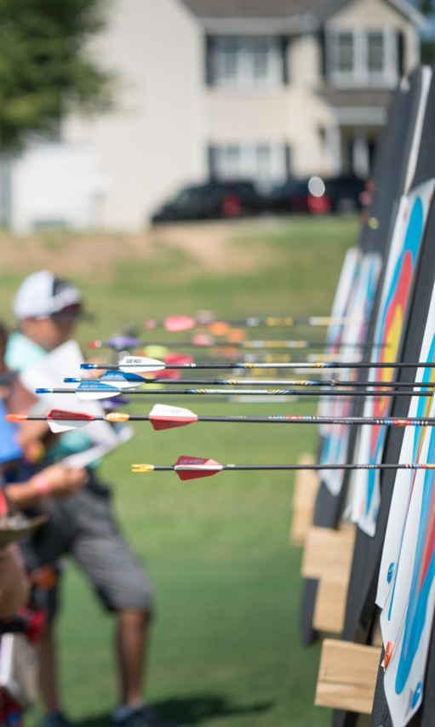
USA ARCHERY POLICIES
SafeSport Code: Available for review on the USA Archery website
Minor Athlete Abuse and Prevention Policy
USA Archery has adopted a Minor Athlete Abuse and Prevention Policy (MAAPP). This policy outlines new requirements for U.S. Center for SafeSport Education Training and Policies for One on One Interactions with Minors.
USA Archery Code of Conduct
As a result of the updates to the SafeSport Code and the adoption of the MAAPP, USA Archery has an updated Code of Conduct, which references these policies.
USA Archery Club and State Association Terms and Conditions
Terms and Conditions require enforcement of MAAPP and Code of Conduct

Slide 4
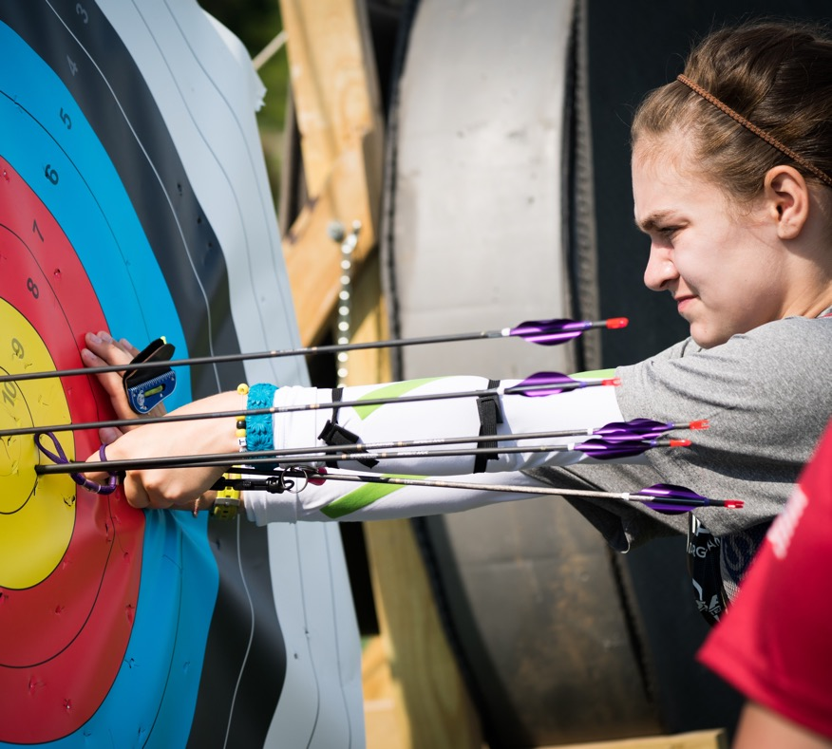
MINOR ATHLETE ABUSE AND PREVENTION POLICIES
Federal law authorizes the Center to address the risk of emotional, physical, and sexual abuse of amateur athletes in the U.S. Olympic and Paralympic Movements (See: Protecting Young Victims from Sexual Abuse and Safe Sport Authorization Act of 2017). The MAAPP is based on recommendations and requirements from the Center
The MAAPP includes an education and training policy and policies for:
One-on-one interactions
Massages and Rubdowns/Athlete Training Modalities
Locker Rooms and Changing Areas
Social Media and Electronic Communications
Local Travel
Team Travel

Slide 5
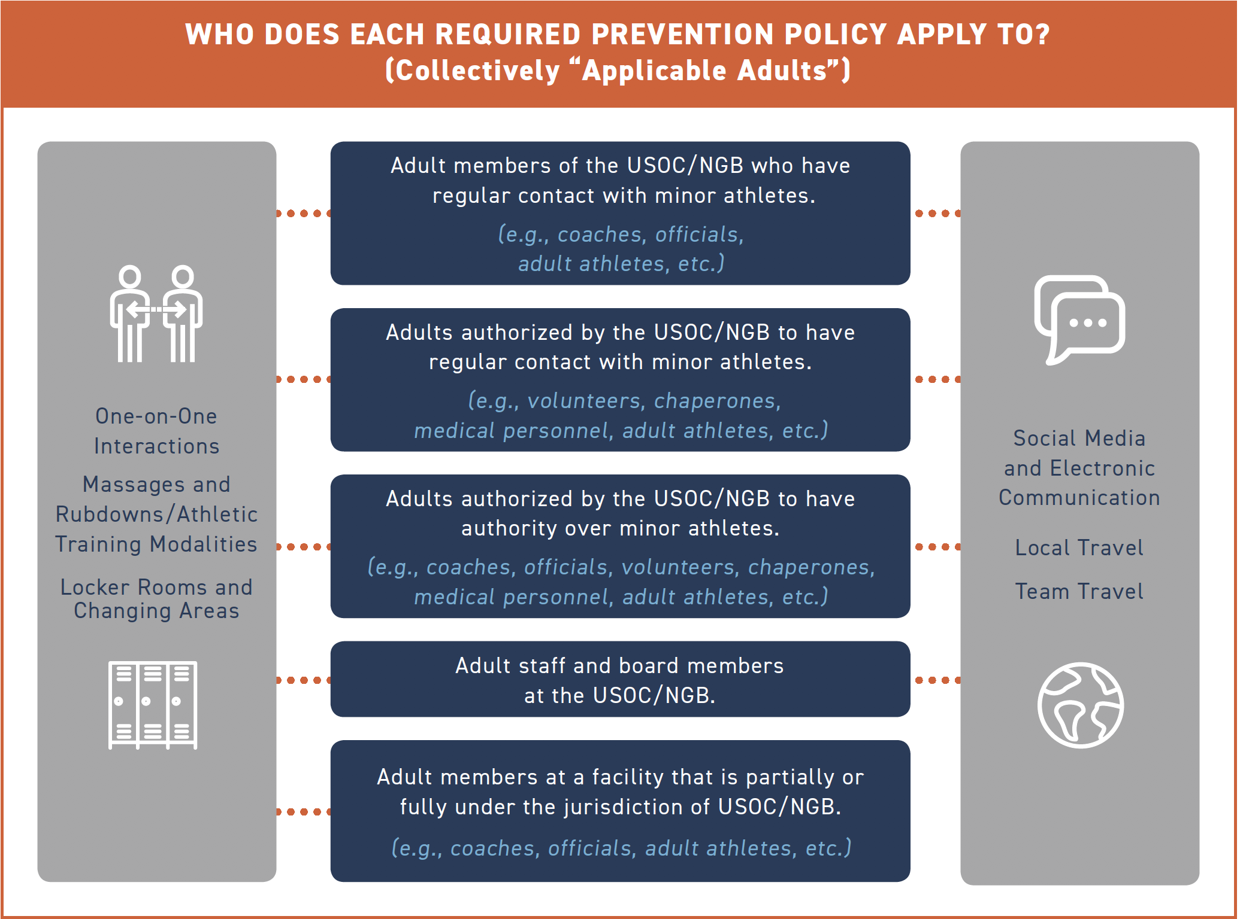

Slide 6
U.S. CENTER FOR SAFESPORT TRAINING AND USA ARCHERY BACKGROUND SCREENING
The Core U.S. Center for SafeSport Training is a 90-minute course
A 30-minute Refresher Course is required on an annual basis effective the calendar year following completion of the Core Training
Refresher Course 1: Recognizing and Reporting Misconduct
Refresher Course 2: Preventing Misconduct
Refresher Course 3: Available Fall 2020
At the fifth year of involvement, user restarts the four-year cycle by taking Core Training Course
Exclusions may be made for volunteers who only have incidental and observable contact with athletes at events on a limited basis
Access training through USA Archery Membership Services Account
USA Archery Background Screening
Good for 2 Years
Cost $35

Slide 7
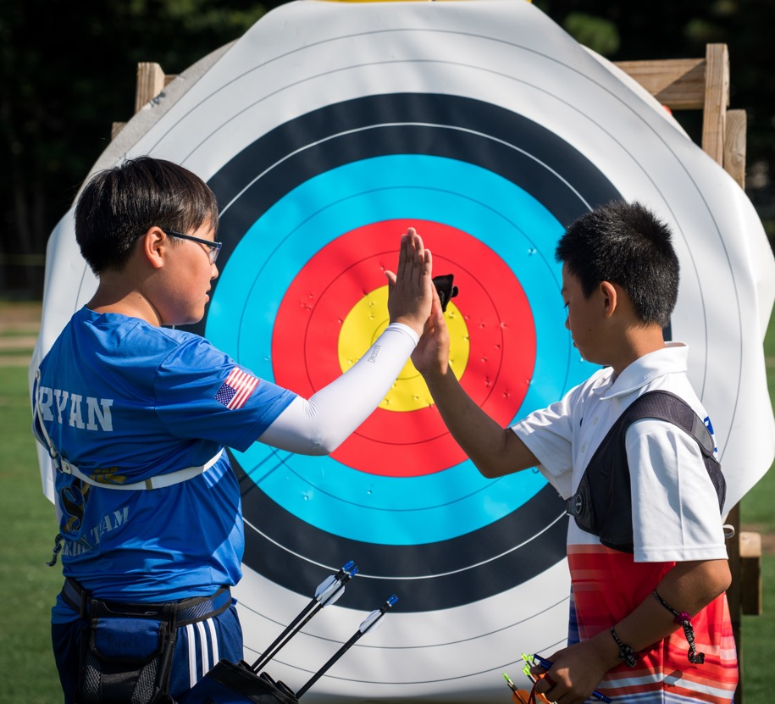
U.S. CENTER FOR SAFESPORT AND BACKGROUND SCREENING POOL
Individuals USAA formally authorizes or appoints to
(a) serve in a position of authority over, or
(b) have frequent contact with athletes.
This shall include, but not be limited to staff, volunteers, coaches, instructors, judges, administrators, board members, trainers, medical personnel and local affiliated administrators/directors.
Assistants, or personal care assistants who are funded, have a contractual obligation with, or are credentialed by USAA, or otherwise have regular contact with USAA athletes.
All athletes and alternates, training partners, and guides who are selected by USAA to participate in national or international teams or Delegation Events.
All athletes and alternates, training partners, and guides that are selected by USAA to train at any Olympic & Paralympic Training Center or USOPC High Performance Training Center.
Individuals affiliated with the media who are authorized or credentialed by USAA to access a training site or attend a competition run by USAA if such individual has unsupervised one-on-one interactions with athletes.
Other individuals who have regular contact with athletes as determined by USAA, in its sole discretion and/or as required by USOPC.

Slide 8
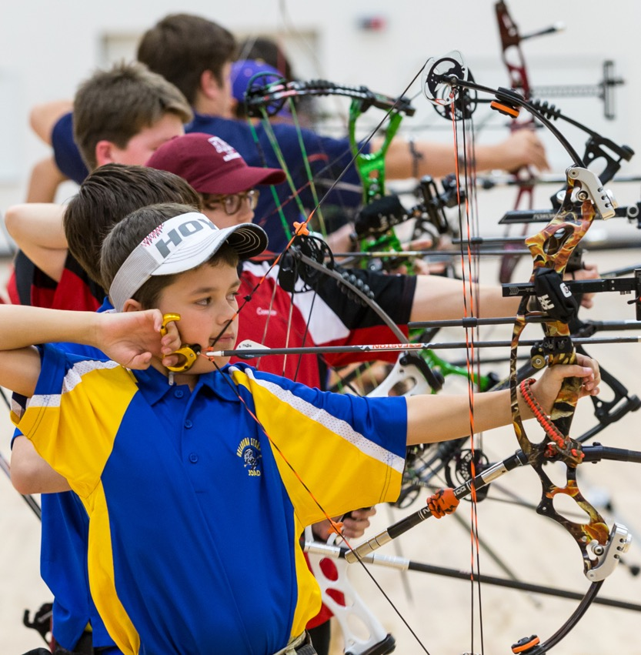
ATHLETE SAFETY PROCEDURES FOR USA ARCHERY EVENT ORGANIZERS
Outline what steps event organizers must take to pre-authorize field of play access for all volunteers, media, vendors, medical personnel, athlete assistants, coaches and judges, etc. (hereafter, “Event Personnel”).
“Event Personnel” are those who have access to the field of play at a USA Archery sanctioned event, while athletes are present.
It is the responsibility of each USA Archery event organizer, club and/or state association to monitor and enforce the requirements set forth in these procedures.

Slide 9
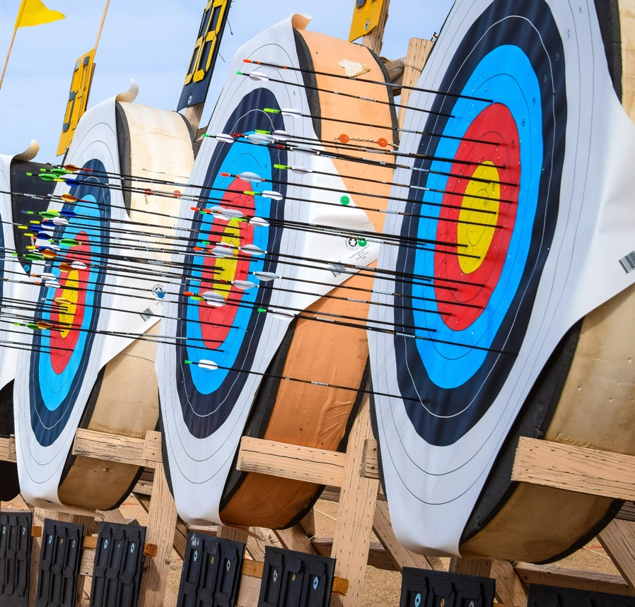
DEFINING EVENT PERSONNEL
Volunteers who set up the field of play before the event and take down equipment after the athletes depart the field of play, are not defined as “event personnel”. Likewise, spectators and vendors who remain off the field of play are also exempt from these requirements.
Those who are required to be pre-authorized include volunteers, event staff, medical personnel, personal athlete assistants, USA Archery coaches and judges, etc. who help with event registration and check-in, or other duties that place them in direct contact with athletes.

Slide 10
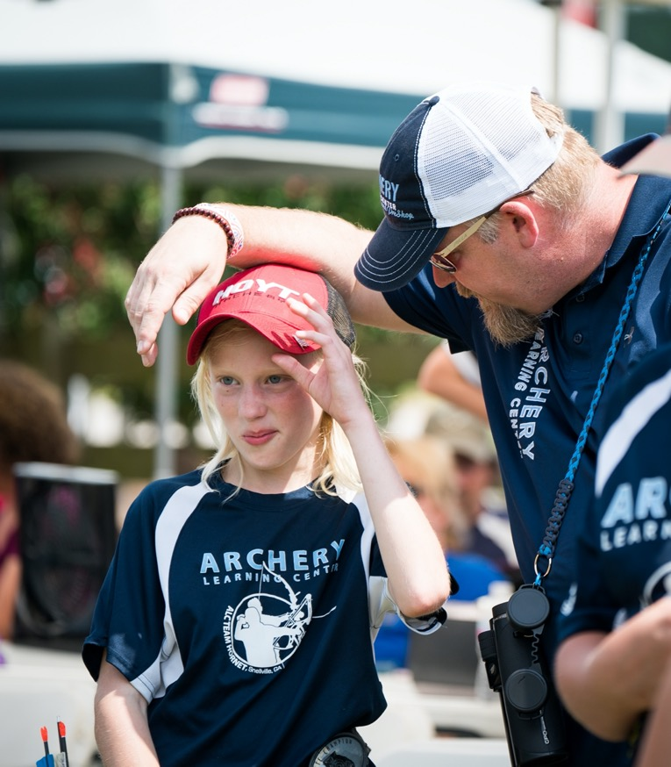
IMPLEMENTATION
USA Archery Event Personnel Tracking Tool is designed to help event organizers maintain a roster of “Event Personnel” for each sanctioned event to include their role and verification that they have completed the necessary requirements.
USA Archery Event Organizers must retain the “Event Personnel Tracking Tool” for a minimum of 5 years for purposes of USA Archery audit, upon request.

Slide 11
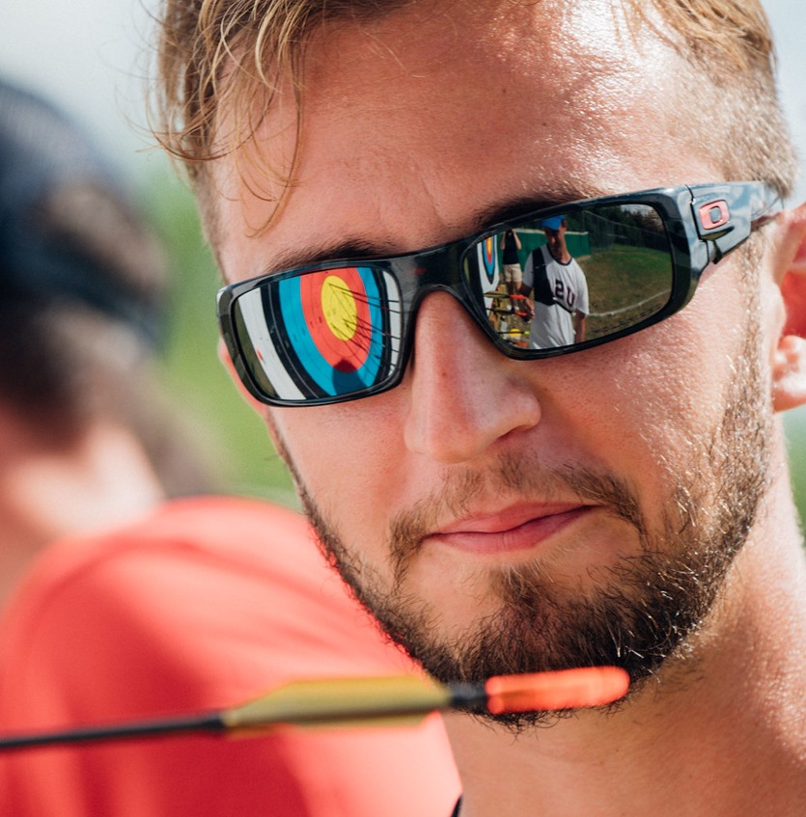
USA ARCHERY NON-ATHLETE PLEDGE
“Event Personnel” who are not members of USA Archery will be required to sign the USA Archery Non-Athlete Pledge to ensure they adhere to the USA Archery Code of Conduct and MAAPP.
This pledge will be good for one year and must be signed annually.

Slide 12
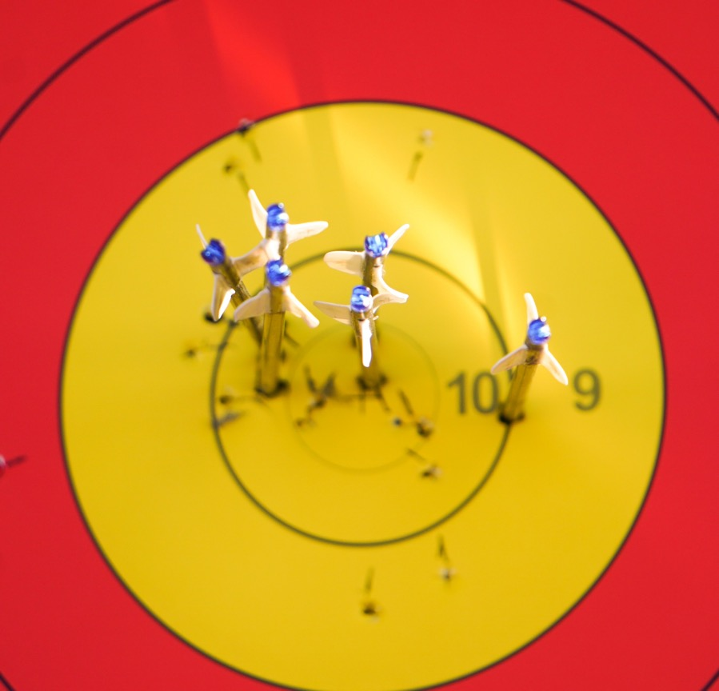
U.S. CENTER FOR SAFESPORT TRAINING
If the “Event Personnel” is not a USA Archery member he or she will be required to create a profile in the USA Archery Membership Services System before the training will be accessible.
This 90-minute training is FREE to all USA Archery members and “Event Personnel”.
Upon completion of the training, “Event Personnel” will receive a certificate of completion, which can be shared with the event organizer.
The event organizer should verify the U.S. Center for SafeSport training will be current through the date of the event.

Slide 13
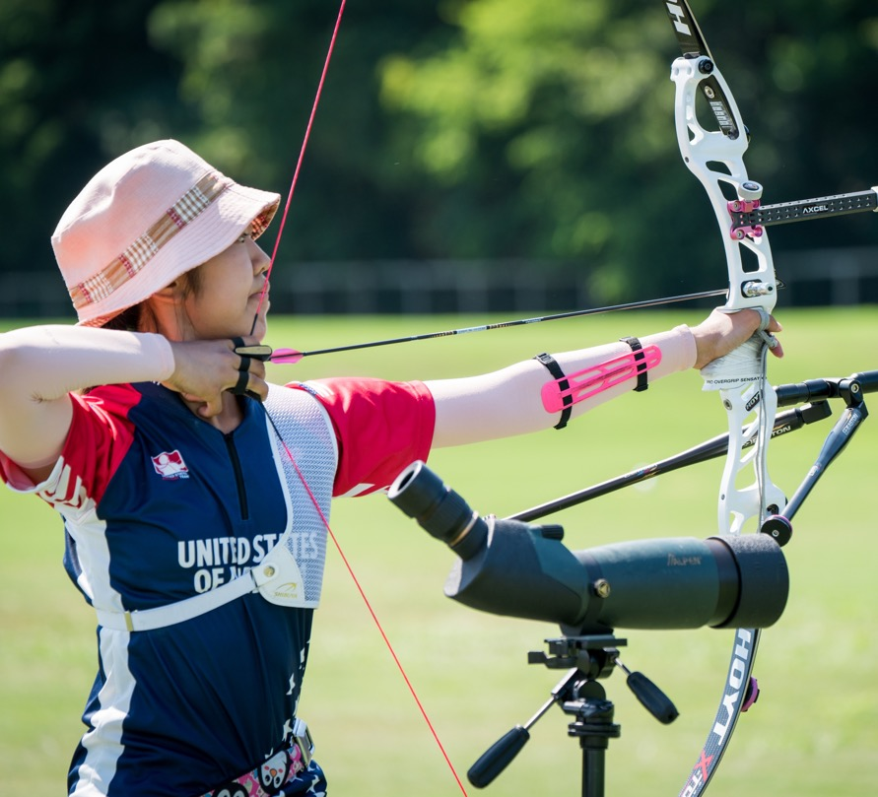
USA ARCHERY BACKGROUND SCREENING
“Event Personnel” may apply for a USA Archery Background Screen by logging in to the USA Archery membership services platform. If the “Event Personnel” is not a USA Archery member he or she will be required to create a profile before a background screen may be added.
The cost will be $35 and the Background Screen will be good for two years from date of completion.
Upon completion of the Background Screen, “Event Personnel” will receive a red or green light status update in their USA Archery account, which can be shared with the event organizer. The event organizer should verify the USA Archery Background Screen will be current through the date of the event.
Exceptions:
Volunteers (Includes Vendors) who only have incidental and observable contact with minor athletes at events are exempt from the USA Archery Background Screening Requirement. Please Note: Background screens from other organizations will not be accepted.
“Arrow Retrievers” for adult Para athletes assigned the day of the event

Slide 14
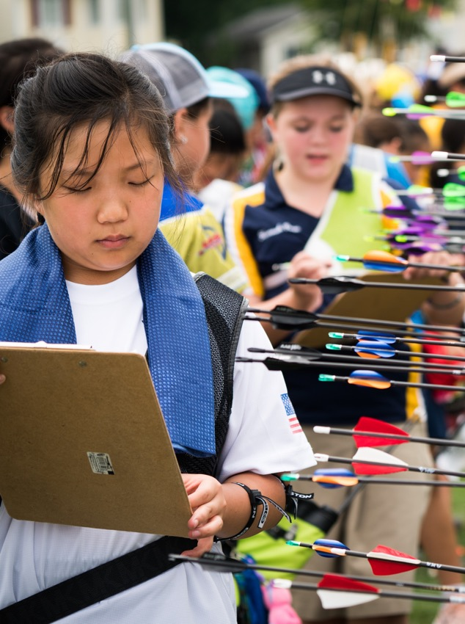
COMMUNICATION OF THE MINOR ATHLETE ABUSE PREVENTION POLICIES
Event organizers must communicate to all registered participants and “Event Personnel” that they will be required to adhere to the MAAPP for the duration of the event.
This information must be communicated no earlier than 30 days prior to the event.
Event Organizers can send emails to registered participants in the USA Archery membership platform.

Slide 15
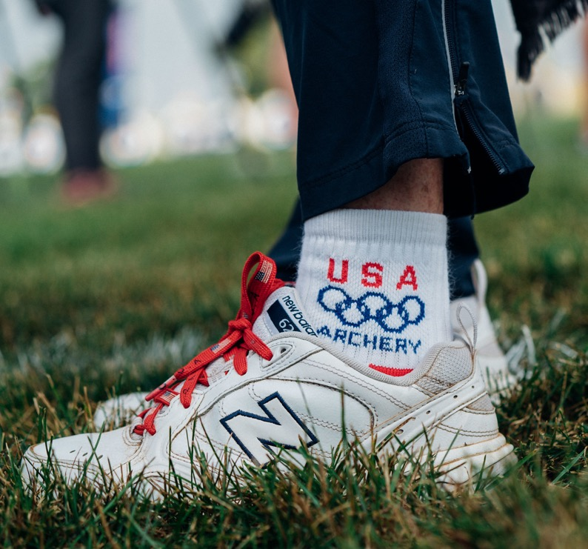
USA ARCHERY SUSPENSION LIST AND ADHERENCE TO THE MAAPP
If an event organizer hosts registration on the Sport80 Platform, it will automatically check for a valid USA Archery membership status, which would preclude anyone with a suspension from entering.
This list is usually very small and even if you are not using the Sport80 platform registration, it will be quick and easy to identify any athlete registrant or Event Personnel for your event who is suspended or banned.
Be sure you have read and are familiar with the MAAPP and complete a risk assessment for your facility.
Archery tournaments are typically held in large, visible, open spaces and have little need for locker rooms or changing areas. Yet, all items within the MAAPP should be evaluated for potential risks before your event.

Slide 16
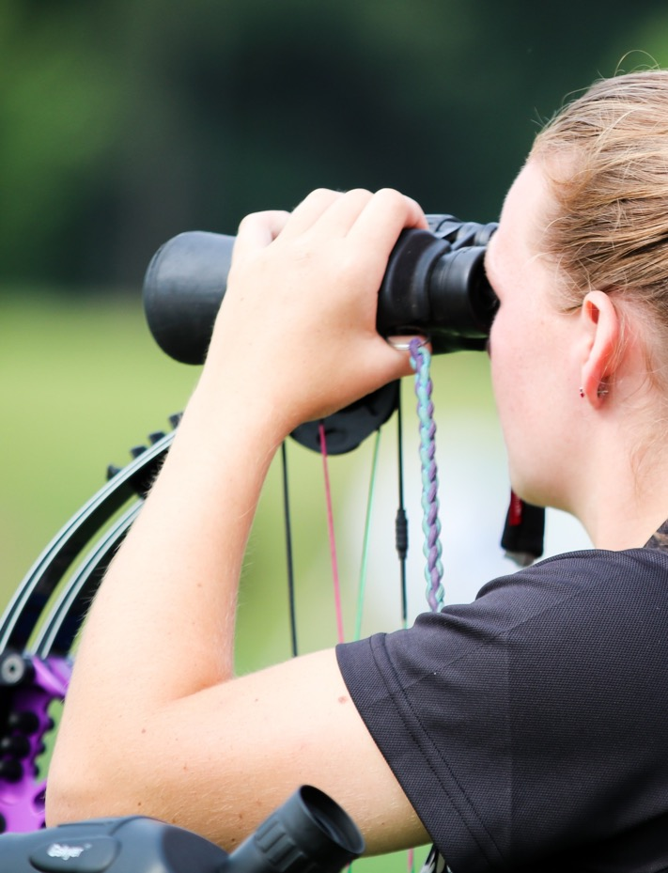
WHEN TO REPORT
The following forms of misconduct should be reported to law enforcement and/or the U.S. Center for SafeSport:
Child Abuse
Sexual Misconduct
All other forms of misconduct (as noted in the SafeSport Code): Please complete the USA Archery SafeSport Reporting Form
Mandatory Reporting:
Every Participant* must report violations of the Code and suspicions or allegations of misconduct. All cases of suspected emotional, physical or sexual abuse of a minor (under the age of 18) must be reported to law enforcement immediately. Filing a report with the Center and/or USAA does not satisfy this obligation.
*Participant
Any individual who is seeking to be, currently is, or was at the time of the alleged Code violation:
A member of USA Archery;
An employee of USA Archery;
Authorized, approved, or appointed by USA Archery to have regular contact with athletes.

Slide 17
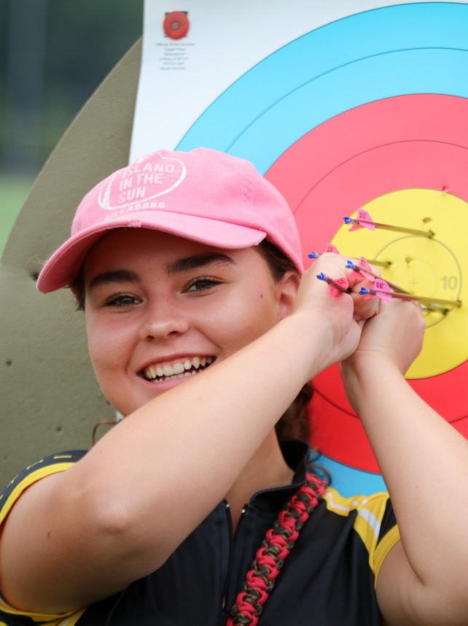
HOW TO REPORT
Center for SafeSport: https://www.safesport.org/report-a-concern
Law Enforcement
Google the appropriate jurisdiction to report
Criminal: where alleged crime took place
Child Abuse: where the child lives
Make the Phone Call
Criminal: law enforcement number
Child Abuse: child abuse hotline
USA Archery: www.usarchery.org
SafeSport Reporting Form

Slide 18
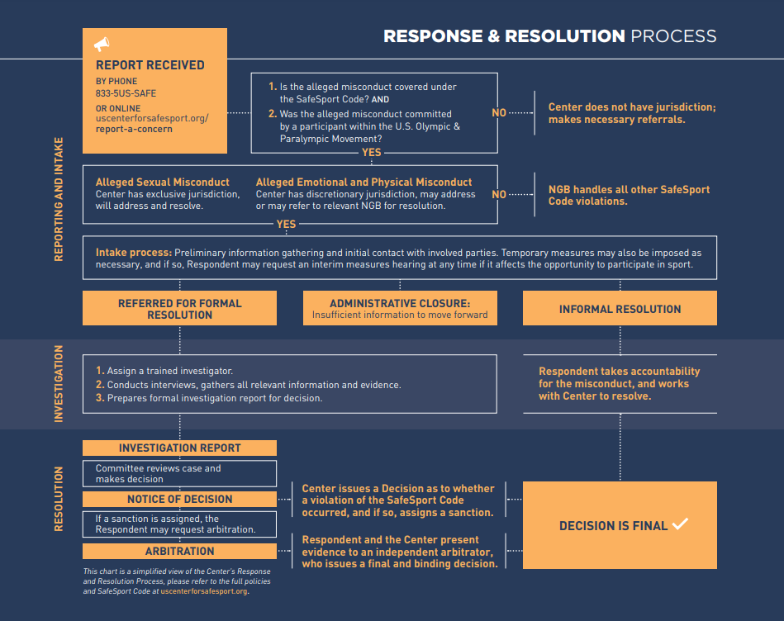

Slide 19
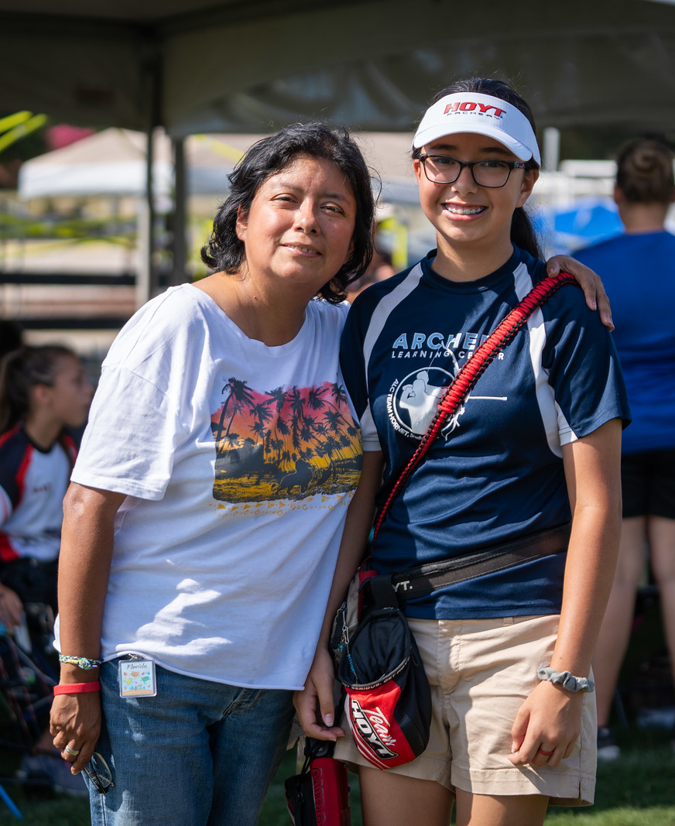
U.S. CENTER FOR SAFESPORT RESOURCES FOR ATHLETES, PARENTS, AND COACHES
Available at www.usarchery.org
Parent Toolkit:
Free Online Parent Training
Complete Parent Toolkit
Parents of Preschool Children
Parents of School-Aged Children
Parents of Middle School Youth
Parents of High School Aged Adolescents
Online Course: Parent’s Guide to Misconduct in Sport

Slide 20
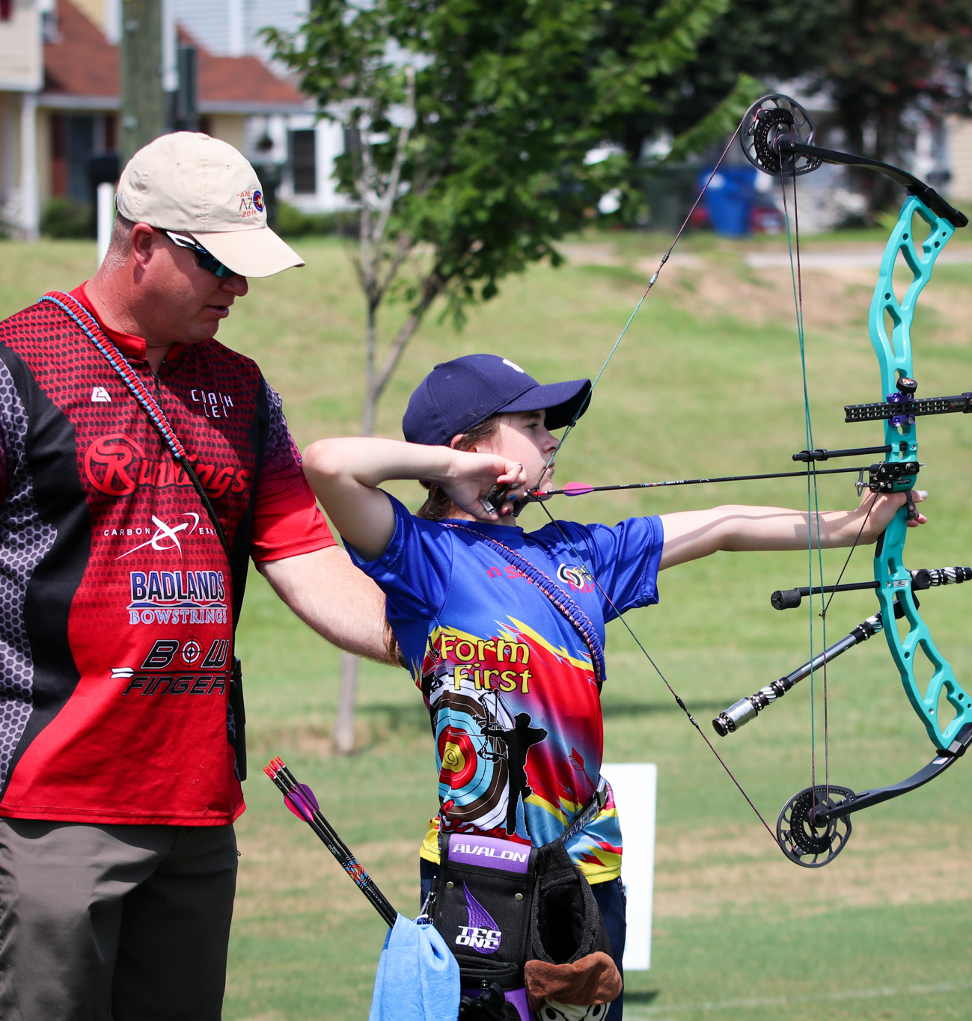
U.S. CENTER FOR SAFESPORT RESOURCES FOR ATHLETES, PARENTS, AND COACHES
Youth Training Courses
Courses for children of pre-school age; grades K-2; grades 3-5; middle school and high school.
These free online trainings are designed as an introduction for minor athletes and their parents or other caregivers to understand the importance of positive, welcoming environments in sports, where misconduct like bullying or abuse is less likely to happen, and to know where to report abuse, should it occur.
Coaches and Club Leaders
Preventing Bullying; What Great Coaches Need to Know
Coaching Boys into Men
Athletes as Leaders

Slide 21
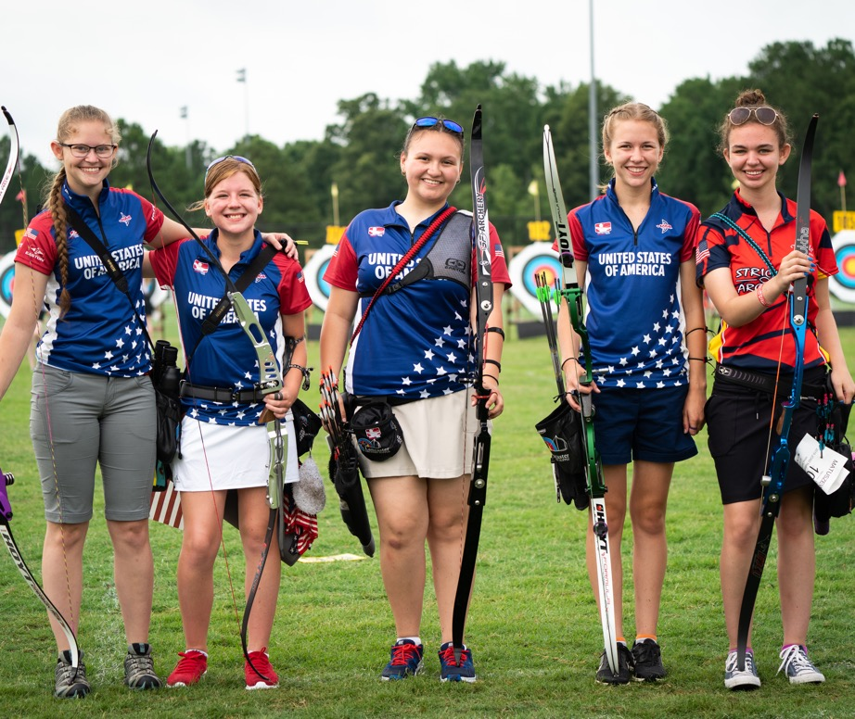
CONCLUSION
Education and awareness are the most critical components to creating safe and respectful sporting environments, free of abuse and harassment.
You are the key to helping end abuse in sport!
Contact Information:
Samantha Bauer
athletesafety@usarchery.org
719-866-3460
Thank You!

